Slide 1
Automated News Categorizing
Proposal Title Presentation

Slide 2
Content
Overview
Problem Statement
Objective of Research
Scope
Significance of Study
Software and Hardware Are Requirement
Relate Work
Methodology

Slide 3
Overview

Slide 4
Problem Statement

Slide 5
Objective of Research
To use the machine learning to categorize news and deployment by using technique of data visualization and data storytelling.
To visualize the categorized news into news timeline visualization in form of data storytelling on a web application.

Slide 6
Scope

Slide 7
Significance of Study
Developer
User
To gets technique skill of data analysis in term of using machine learning to apply with news categorizing.
To deployment the result on web application by using python.
User can follow the trend of news are viral in social during that time.
User gets quick access to relevant news and topics of interest.

Slide 8
Software and Hardware are Requirement

Slide 9
Software Requirement
Resource
Data Mining Process
News from Bangkok post agency website.
Python
Jupyter Notebook
Data Mining Libraries
Requests
Beautiful Soup 4
Pandas
NumPy
re (Regular Expression)

Slide 10
Software Requirement
Data Visualization Process
Data Base
Web Application Language
HTML
JavaScript
Css
Python
Data Visualization Libraries
Django
Matplotlib
Seaborn
MySQL
Data Integration Format
JSON

Slide 11
Hardware Requirement
Personal Computer
Asus VivoBook 15 x512da
HP Pavilion Power 15-cb035TX

Slide 12
Relate Work

Slide 13
Automated Semantic Categorization of News Headlines Using Ensemble Machine Learning: A Comparative Study. (Bogery et al., 2019)
Automated Text Tagging of Arabic News Articles Using Ensemble Deep Learning Models. (Elnagar et al., 2019)

Slide 14
Methodology

Slide 15
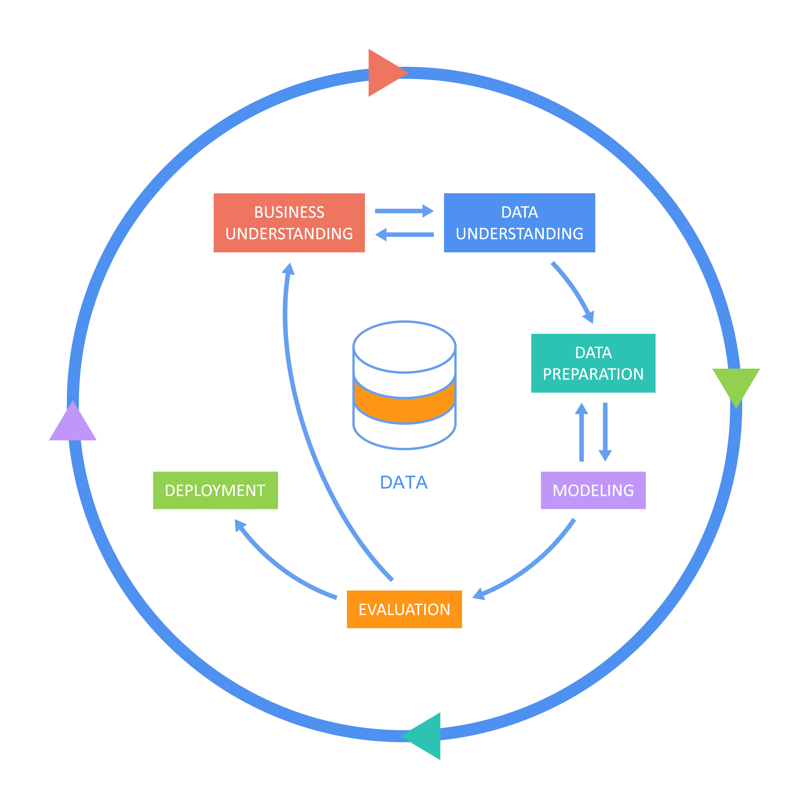
CRISP-DM

Slide 16
Methodology
Categorizing news automatically by using machine learning SVM (Support Vector Machine).
Resource
Bangkok post agency website.
File extension
JSON.
NLP (Natural Language Processing).
Business Understanding
Data Understanding
Data Preparation

Slide 17
Methodology
SVM (Support Vector Machine).
Model Evaluation.
Web Application.
Modelling
Evaluation
Deployment

Slide 18
Thank You :)

